Slide 1
EN.601.414/614 Computer Networks Misc
Xin Jin
Fall 2020 (TuTh 1:30-2:45pm on Zoom)
https://github.com/xinjin/course-net
Notes:
Slides adapted from similar courses at Princeton, Stanford, UC Berkeley, University of Michigan, etc.

Slide 2
Assignments
The grades for assignment 3 are out
Average: 9.45, median: 10.0, std dev: 1.8
Great job!
Assignment 4 is due next Tuesday
Keep going

Slide 3
Agenda
Software-Defined Networking
Cloud Computing
Network Virtualization
Network Testing and Verification
Big Network Data Processing
AI and Networking
Internet of Things
Bitcoin and Blockchain

Slide 4
Traditional Computer Networks
Data plane:
Packet processing
Forward, filter, buffer, mark,
rate-limit, and measure packets

Slide 5
Traditional Computer Networks
Control plane:
Distributed algorithms
Track topology changes, compute routes, install forwarding rules

Slide 6
The Call for a Change
Simpler management
No need to “invert” control-plane operations
Faster pace of innovation
Less dependence on vendors and standards
Easier interoperability
Compatibility only in “wire” protocols
Simpler, cheaper equipment
Minimal software

Slide 7
Software Defined Networking (SDN)
Logically-centralized control
Smart,
slow
API to the data plane
(e.g., OpenFlow)
Dumb,
fast
Switches

Slide 8
Controller: Programmability
Controller Application
Network OS
Events from switches
Topology changes,
Traffic statistics,
Arriving packets
Commands to switches
(Un)install rules,
Query statistics,
Send packets

Slide 9
A Helpful Analogy
From Nick McKeown’s talk “Making SDN Work” at the Open Networking Summit, April 2012

Slide 10
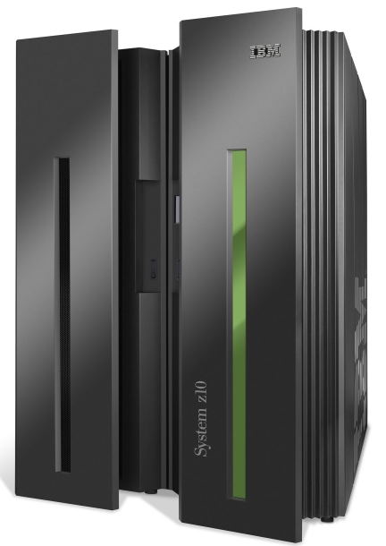
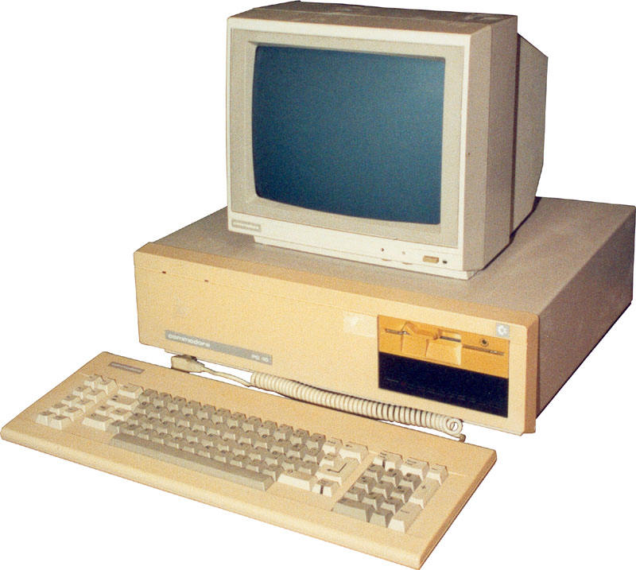
Mainframes
App
App
App
App
App
App
App
App
App
App
App
Specialized
Applications
Open Interface
Windows
(OS)
Linux
Mac
OS
Specialized
Operating
System
or
or
Open Interface
Specialized
Hardware
Microprocessor
Vertically integrated
Closed, proprietary
Slow innovation
Small industry
Horizontal
Open interfaces
Rapid innovation
Huge industry

Slide 11
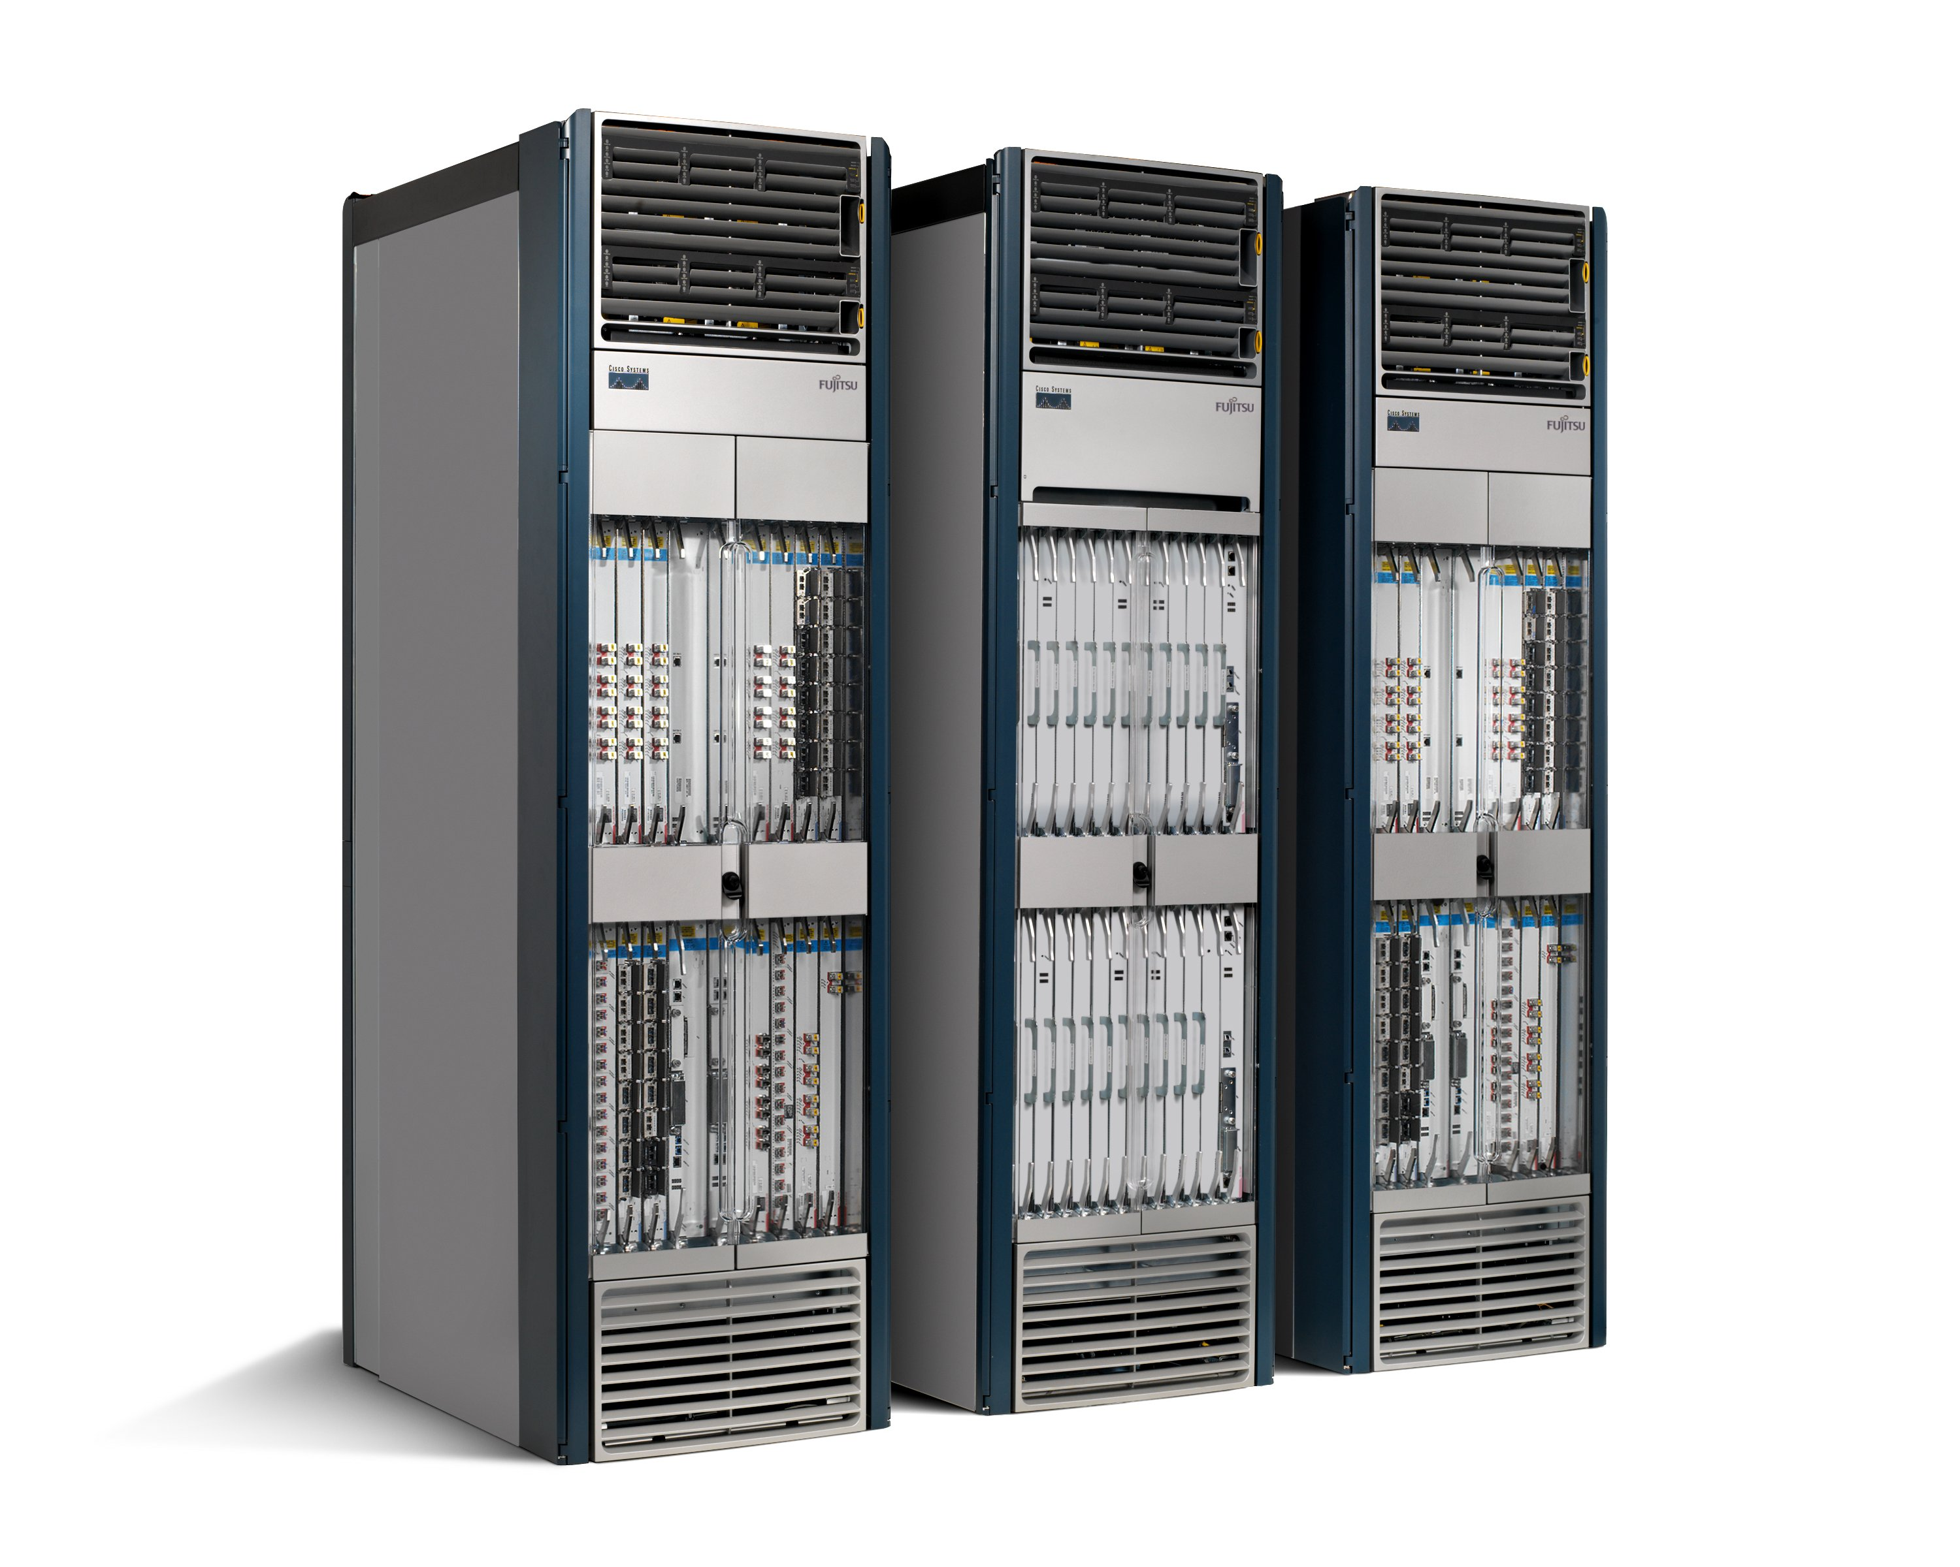
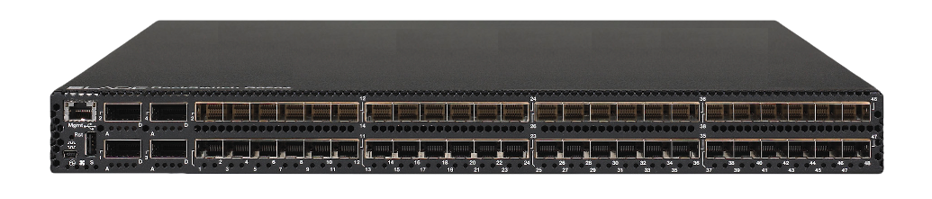
Routers/Switches
App
App
App
App
App
App
App
App
App
App
App
Specialized
Features
Open Interface
Control
Plane
Control
Plane
Control
Plane
or
or
Specialized
Control
Plane
Open Interface
Specialized
Hardware
Merchant
Switching Chips
Vertically integrated
Closed, proprietary
Slow innovation
Horizontal
Open interfaces
Rapid innovation

Slide 12
Agenda
Software-Defined Networking
Cloud Computing
Network Virtualization
Network Testing and Verification
Big Network Data Processing
AI and Networking
Internet of Things
Bitcoin and Blockchain

Slide 13
Who’s serving Web services?
Server
User
HTTP GET

Slide 14
Who’s serving Web services?
<html>
<body>
... …
</body>
</html>
Server
User
HTTP Response

Slide 15
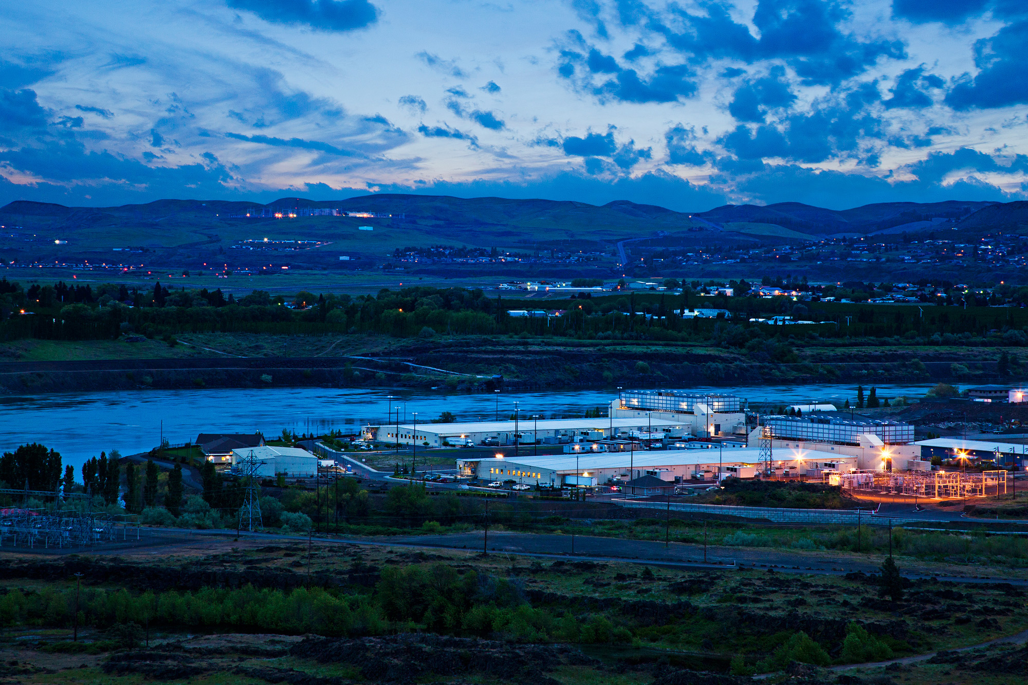
Who’s serving Web services? Datacenters
Source: Google

Slide 16
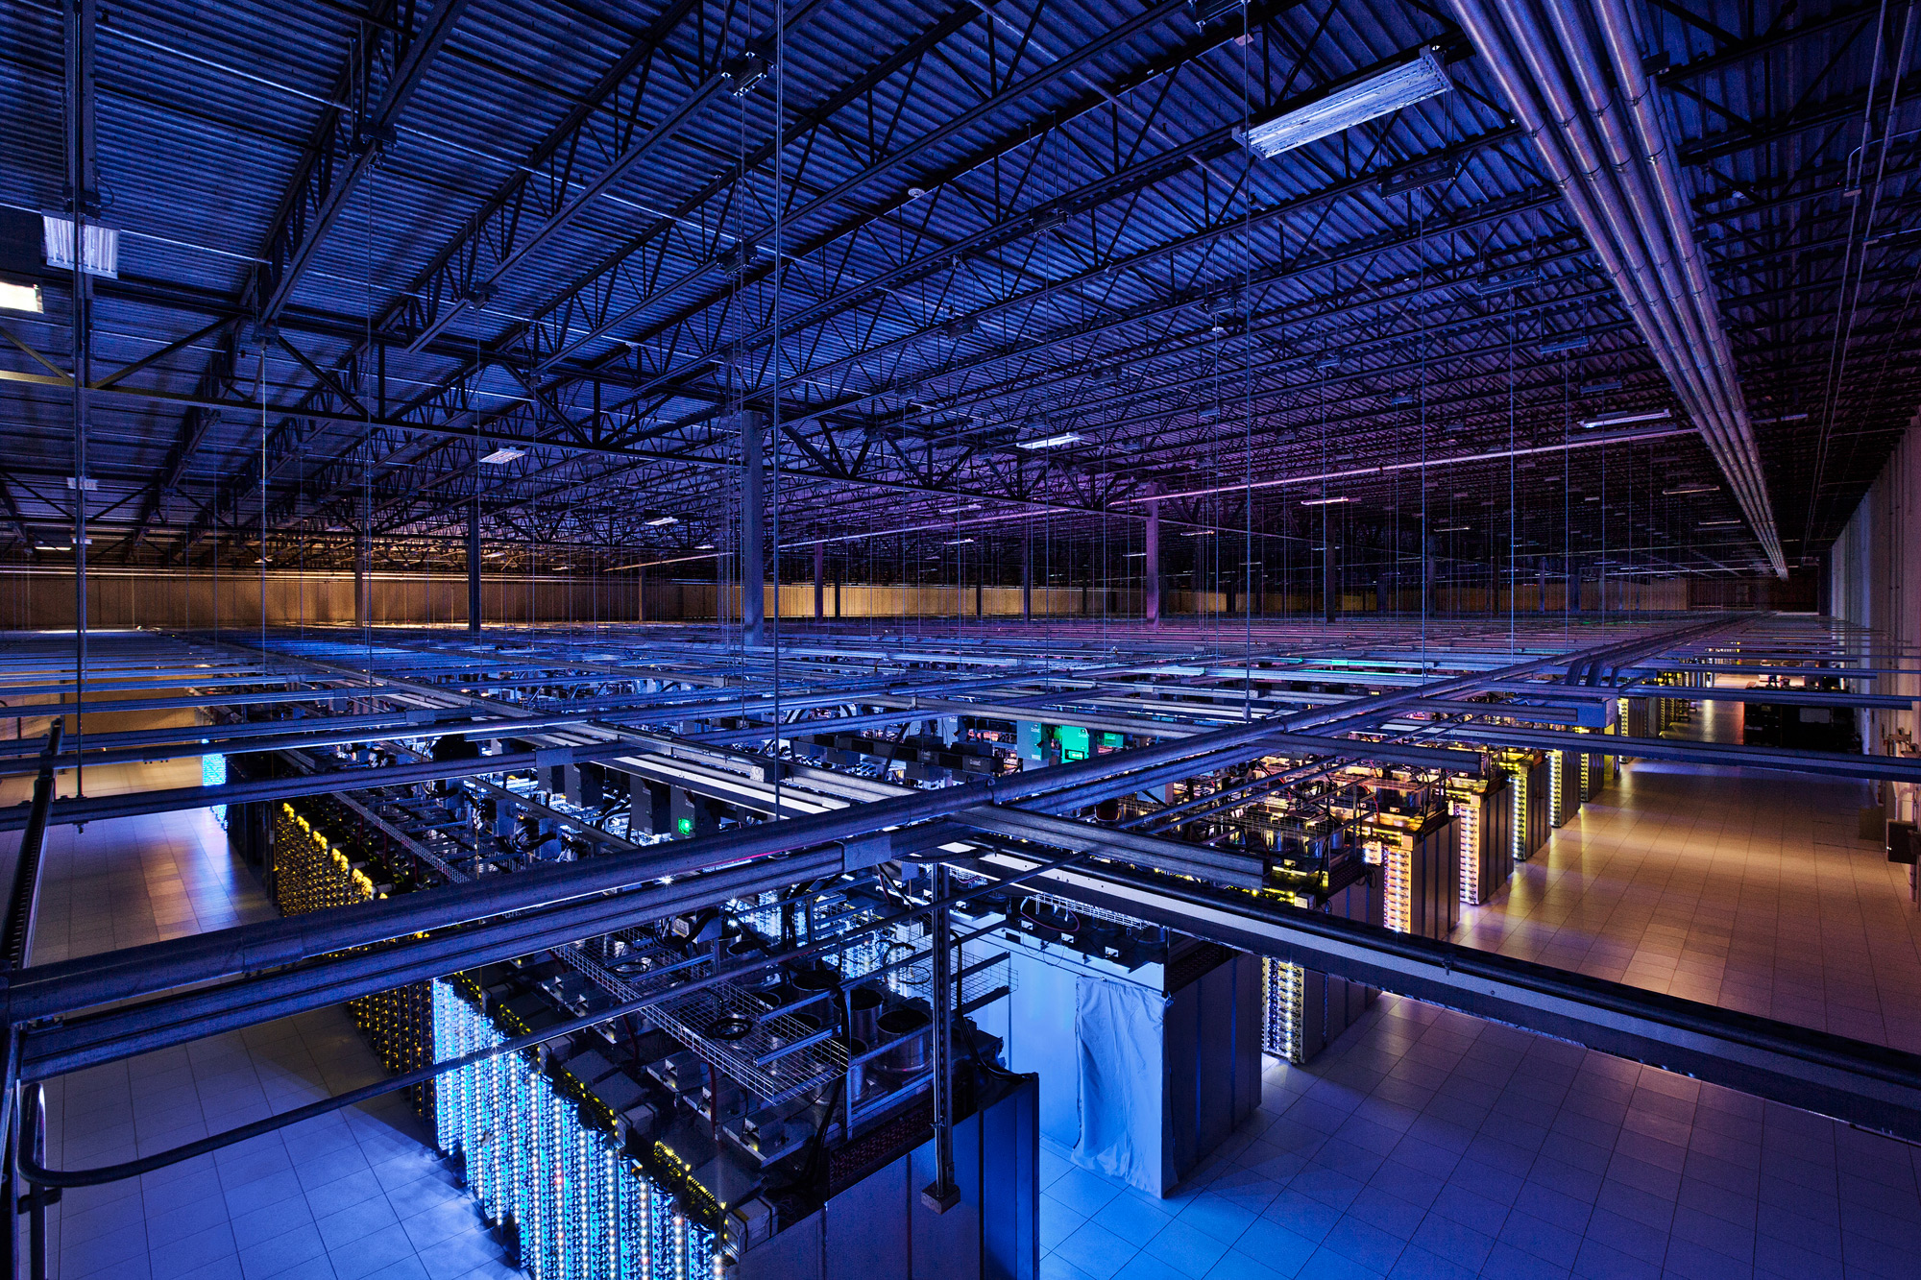
Who’s serving Web services? Datacenters
Source: Google

Slide 17
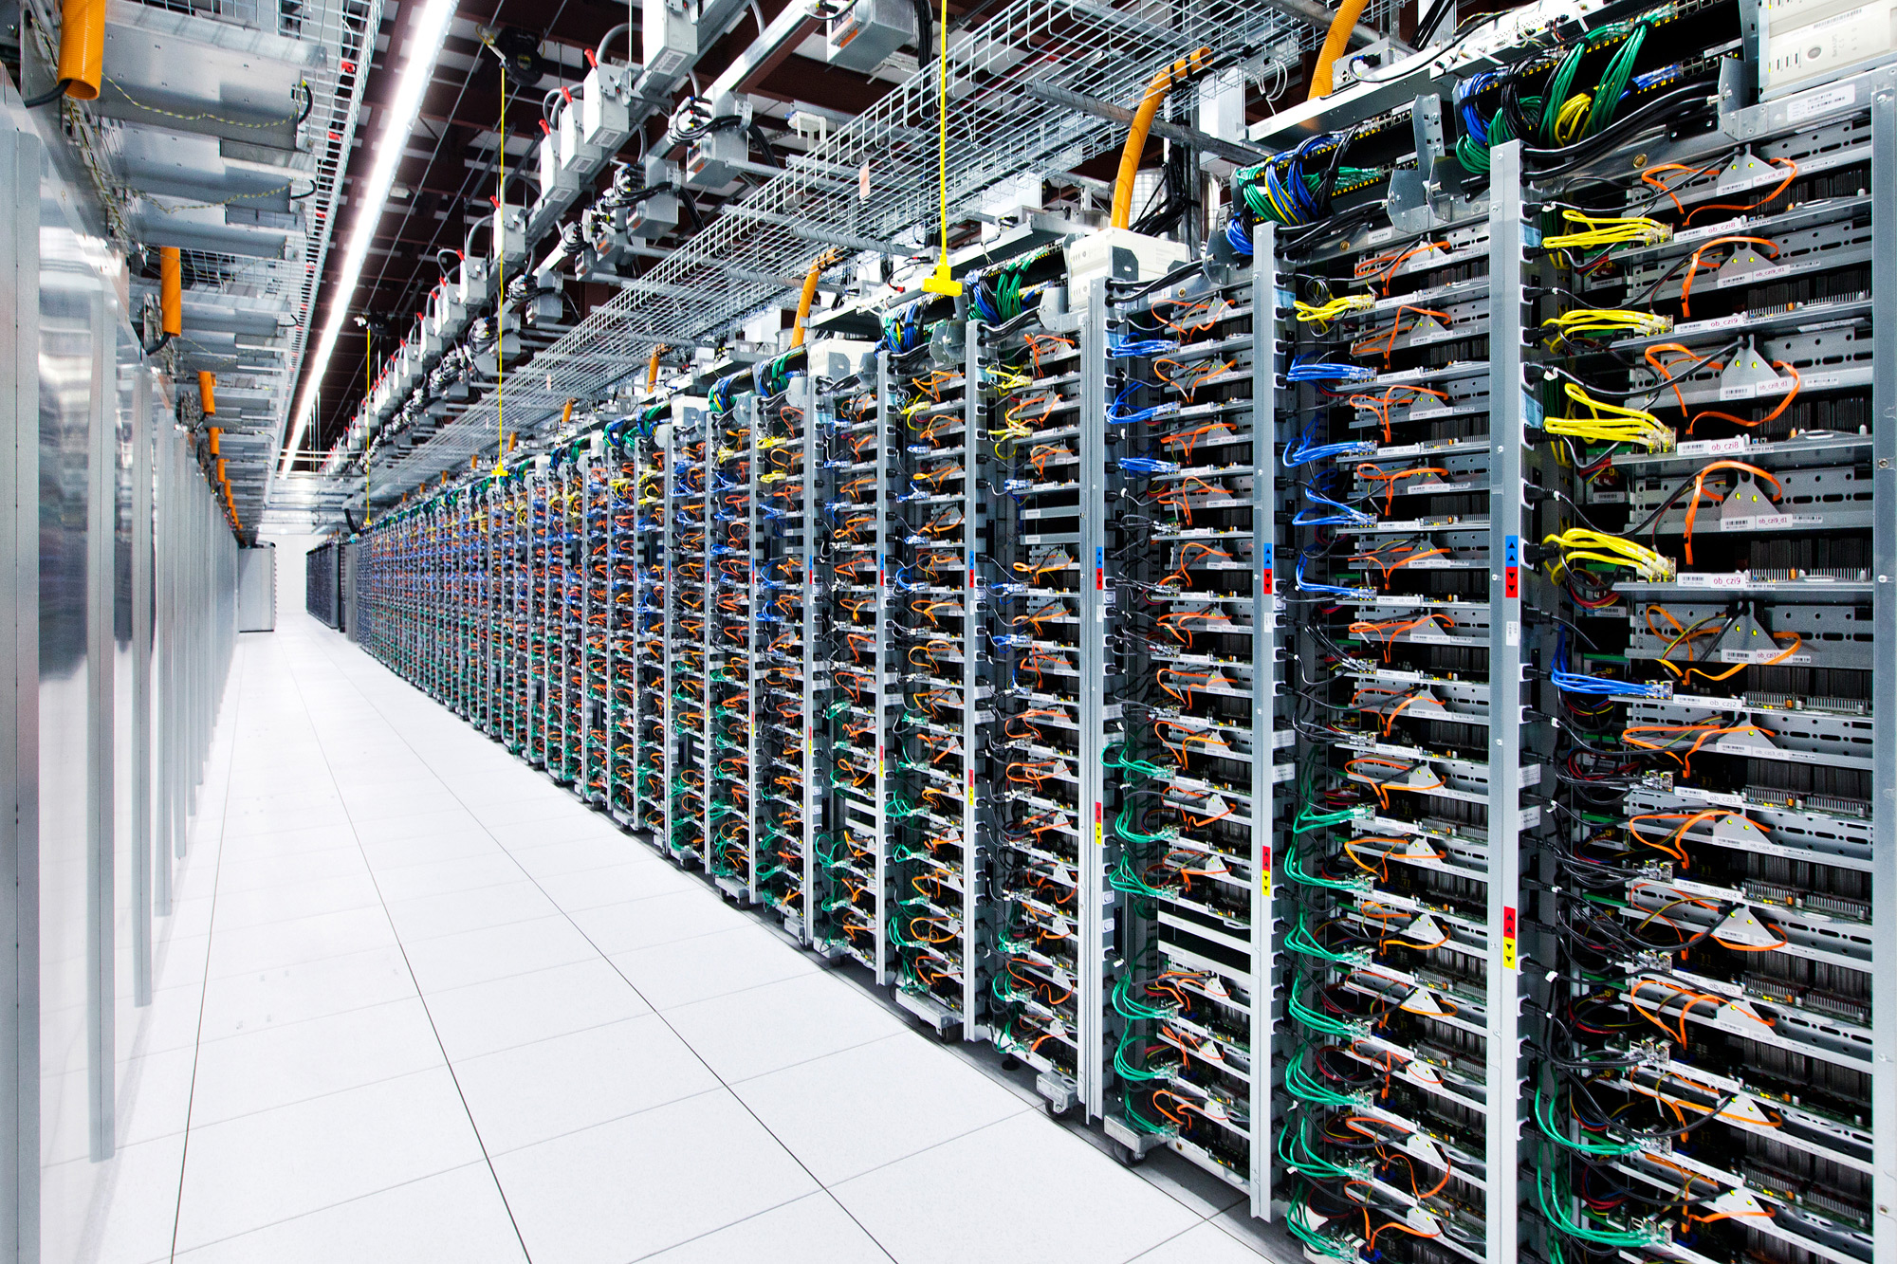
Who’s serving Web services? Datacenters
Source: Facebook

Slide 18
Datacenter networks
Tens to hundreds of thousands of hosts, often closely coupled, in close proximity:
E-commerce (e.g., Amazon)
Content servers (e.g., Netflix, YouTube, Apple, Microsoft)
Search engines, data mining (e.g., Google)
Social networks (e.g., Facebook, Twitter, Instagram)
Challenges:
Multiple applications, each serving massive numbers of clients

Slide 19
How big exactly?
1M servers/site [Microsoft/Amazon/Google]
> $1B to build one site [Facebook]
>$20M/month/site operational costs [MS’09]
End-user spending on global data center infrastructure is projected to reach $200 billion in 2021. [Gartner report]
But only O(10-100) sites

Slide 20
Datacenter networks
Aggregation
ToR Switch
Server

Slide 21
Datacenter networks (Cont.)
Core
Aggregation
Rack

Slide 22
Challenges
Not enough bandwidth
Oversubscription: Less bandwidth in the ToR-Agg links than all the servers bandwidth in the rack
Oversubscription ratio: Ratio between bandwidth underneath and bandwidth above
Not enough paths between server pairs
Load balancing issues
Failure recovery issues

Slide 23
Modern datacenter networks: More bandwidth, more paths
Core
Aggregation
Rack

Slide 24

Let’s take a Web service
Johns Hopkins University

Slide 25
Who’s serving Web services?
Core
Aggregation
Rack

Slide 26

What happens inside?
Johns Hopkins University
Top-level Aggregator
Mid-level Aggregators
Workers

Slide 27
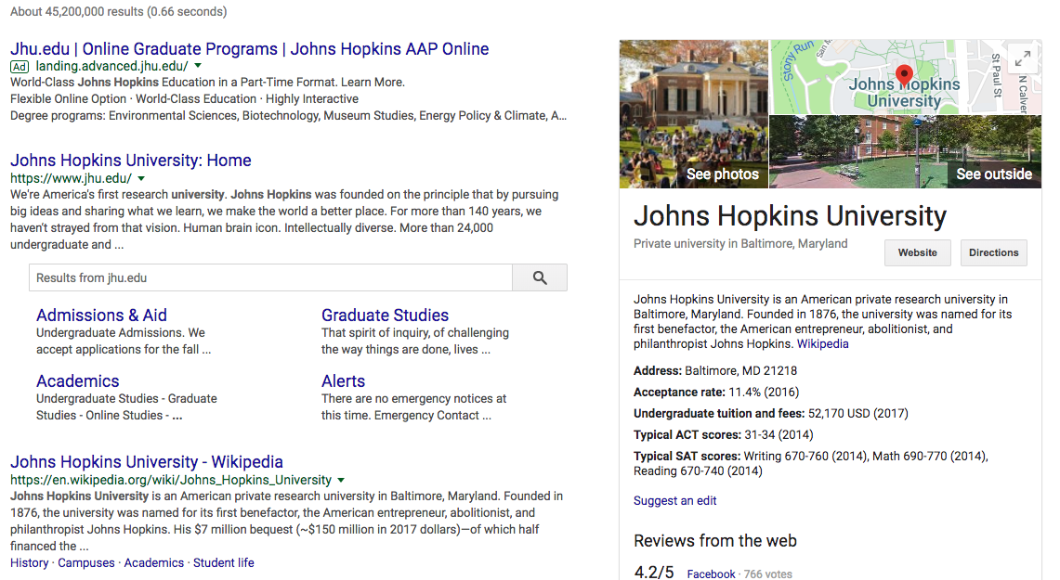
Partition-Aggregate traffic
Johns Hopkins University
Top-level Aggregator
Mid-level Aggregators
Workers

Slide 28
Partition-Aggregate traffic
Core
North-South Traffic
Aggregation
Rack
East-West Traffic

Slide 29
End-to-end response time
Less than 200 milliseconds between receiving user query in the browser and displaying the results
RTT = O(10) to 100 milliseconds
What remains?
Next time, when the page is not loading fast enough, think about the poor servers working for you ☺

Slide 30
Agenda
Software-Defined Networking
Cloud Computing
Network Virtualization
Network Testing and Verification
Big Network Data Processing
AI and Networking
Internet of Things
Bitcoin and Blockchain

Slide 31
What are we talking about when we talk about network virtualization?

Slide 32
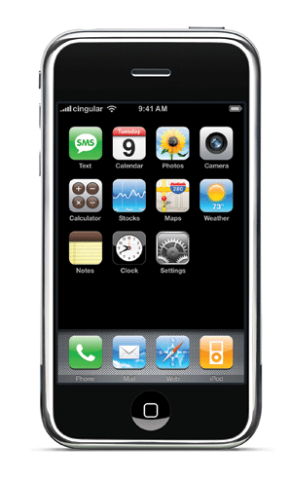

Network Virtualization of the “Network”
Controller #1
Controller #2
Controller #3
Partition the space of packet headers

Slide 33
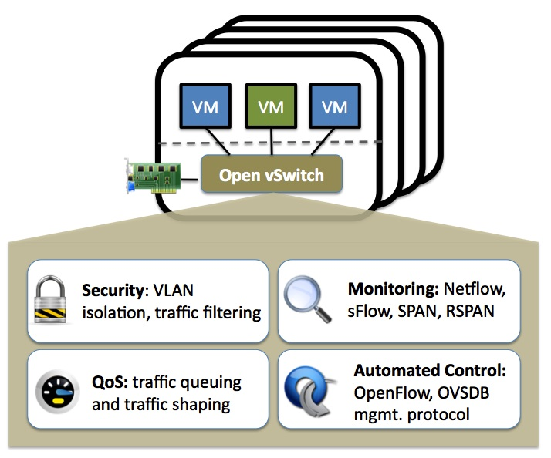
Network Virtualization of the “Host”

Slide 34
Agenda
Software-Defined Networking
Cloud Computing
Network Virtualization
Network Testing and Verification
Big Network Data Processing
AI and Networking
Internet of Things
Bitcoin and Blockchain

Slide 35
Network Testing and Verification
What problems to test and verify?
Reachability
Loop
Blockhole
Policy: access control, isolation for multi-tenancy
How to test and verify?
Control plane
Analyze switch configuration files
Data plane
Analyze flow tables in switches
Passively collect network measurements
Actively inject test packets

Slide 36
Agenda
Software-Defined Networking
Cloud Computing
Network Virtualization
Network Testing and Verification
Big Network Data Processing
AI and Networking
Internet of Things
Bitcoin and Blockchain

Slide 37


Big Network Data Processing
Network management
Network-wide flow statistics
Traffic distribution
Flow
cardinality
Heavy
hitters

Slide 38
Big Network Data Processing
Sketch: a promising solution
A family of randomized algorithms
Key idea: project high-dimensional data into small subspace
Subspace reflects mathematical properties
Strong theoretical error bounds when querying for statistics
High-dimensional data
Randomized projection
Input data
Statistics
Subspace
Data structure
Small subspace:
low computation & communication overheads

Slide 39
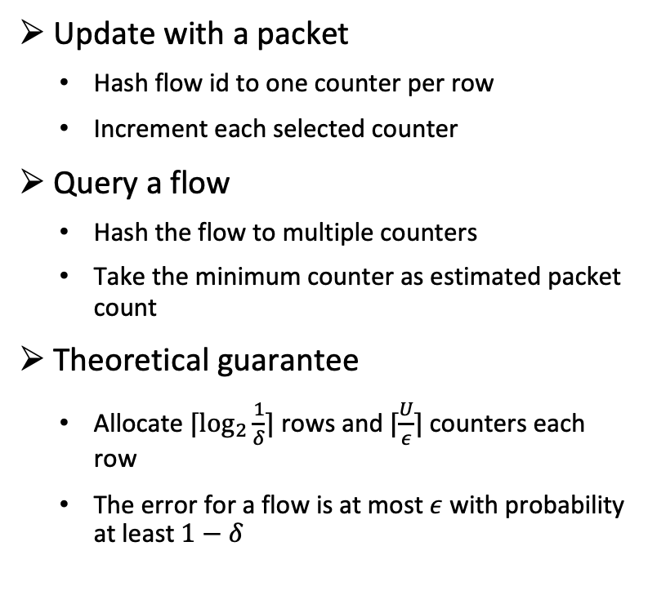
Big Network Data Processing
Example: count flow packets with Count-Min sketch
Update with a packet
Hash flow id to one counter per row
Increment each selected counter
Query a flow
Hash the flow to multiple counters
Take the minimum counter as estimated packet count
Theoretical guarantee
Allocate $⌈\log_{2}{\frac{1}{δ}}⌉$ rows and $⌈\frac{U}{ε}⌉$ counters each row
The error for a flow is at most $ε$ with probability at least $1−δ$
+1
Packet
+1
+1
+1
Each element is a counter

Slide 40
Agenda
Software-Defined Networking
Cloud Computing
Network Virtualization
Network Testing and Verification
Big Network Data Processing
AI and Networking
Internet of Things
Bitcoin and Blockchain

Slide 41



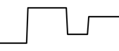

AI and Networking
AI for networking
Apply AI to solve networking problems, e.g., video streaming, routing, congestion control
Example: apply deep reinforcement learning to bitrate adaptation for better Quality of Experience (QoE) [SIGCOMM’17 Pensieve]
bandwidth
ABR agent
bitrates
240P
bit rate
480P
720P
buffer
720P
1080P
network and video measurements

Slide 42
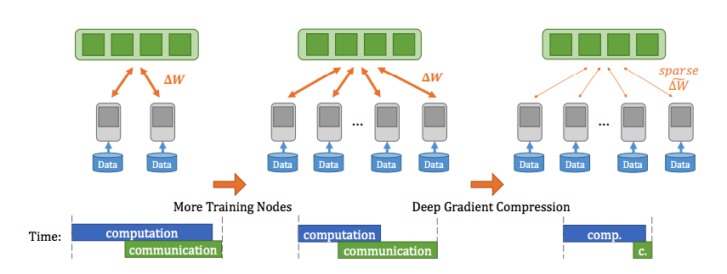
AI and Networking
Networking for AI
Apply networking to solve AI problems, e.g., improve communication efficiency for training and serving
Example: compress gradients to reduce communication to speed up distributed training of DNNs [ICLR’18 DGC]

Slide 43
Agenda
Software-Defined Networking
Cloud Computing
Network Virtualization
Network Testing and Verification
Big Network Data Processing
AI and Networking
Internet of Things
Bitcoin and Blockchain

Slide 44

Internet of Things
Internet-connected things are everywhere [MobiCom’19 Living IoT]
Notes:
https://www.youtube.com/watch?v=0_i0K3jcp8Y

Slide 45
Internet of Things
And, we need to collect and analyze the data collected from all of them [SIGCOMM’18 AWStream]

Slide 46
Agenda
Software-Defined Networking
Cloud Computing
Network Virtualization
Network Testing and Verification
Big Network Data Processing
AI and Networking
Internet of Things
Bitcoin and Blockchain

Slide 47
What is bitcoin?
Bitcoin is money.
What is money?

Slide 48

Types of Money
Paper

Slide 49

Types of Money
Gold, silver, and precious metals

Slide 50
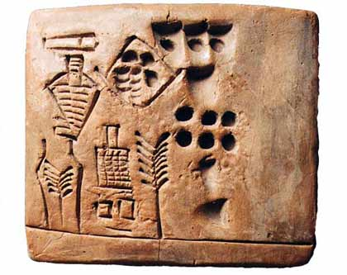
Types of Money
Grains and other crops

Slide 51
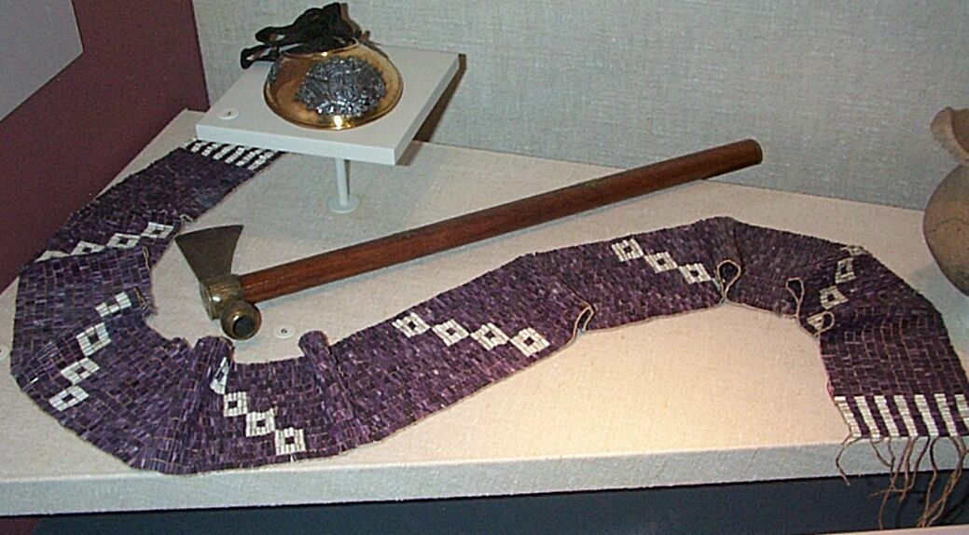
Types of Money
Shells (e.g. wampum)

Slide 52


Types of Money
Ramen noodles

Slide 53

Types of Money
Digital currencies: a number on your digital (banking) account

Slide 54
Bitcoin and Digital Currencies
Advantages of digital currencies
Easy to produce
Easy to use
Easy to store
Bitcoin is a decentralized digital currency without a central bank or single administrator that can be sent from user to user on the peer-to-peer bitcoin network without the need for intermediaries.
Bitcoin, and Cryptocurrencies in general, are just one type of digital currencies
Key feature: decentralization, no central bank or single administrator

Slide 55
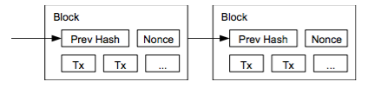
Bitcoin and Blockchain
Bitcoin is realized by the blockchain technology
A blockchain is a linked list of blocks
Each block contains a set of transactions
The blockchain stores the entire transaction history
The blockchain is replicated in all participants
No need to trust any single entity
It works as long as more than half of the participants are honest

Slide 56
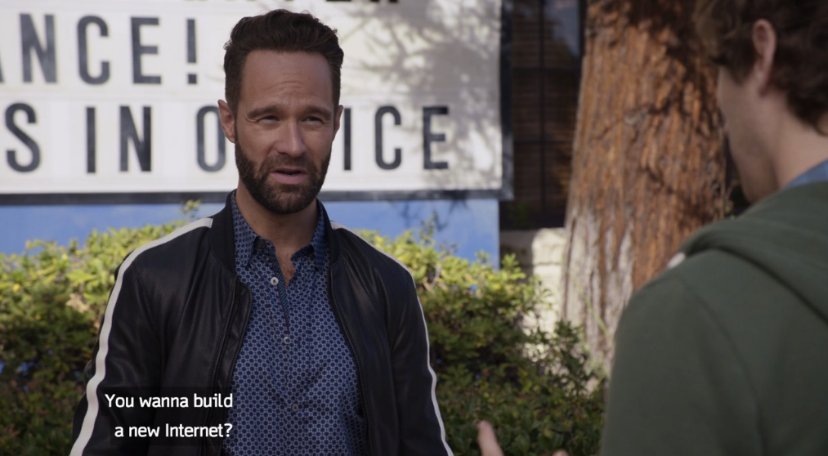
And then, the new Internet…
Notes:
HBO Silicon Valley

Slide 57
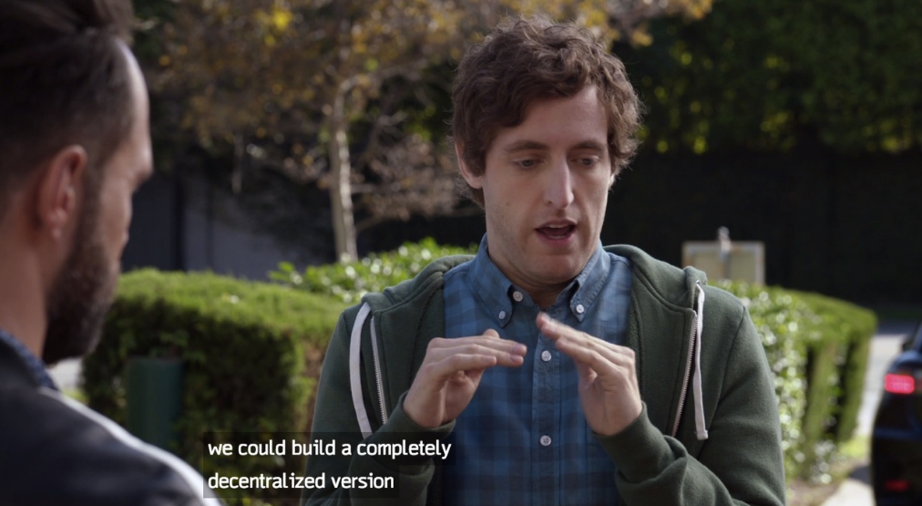
And then, the new Internet…

Slide 58
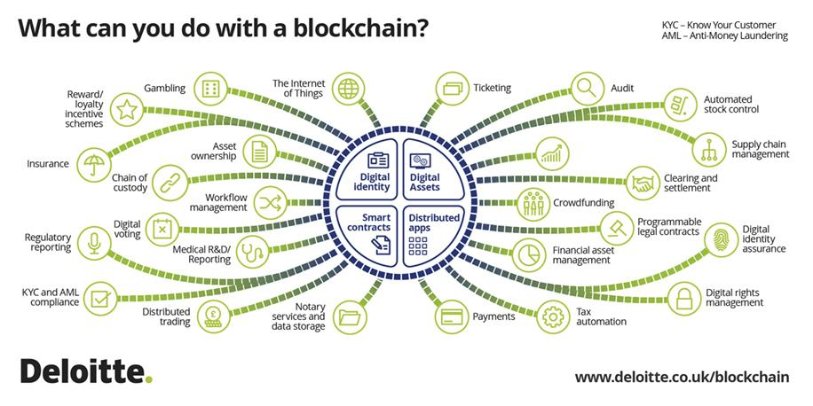
And then, the new Internet…
Blockchain enables a new generation of decentralized Internet applications
Bitcoin is only one of them
Still a hype…

Slide 59
Group Discussion
Topic: the future of Internet
What problems does the current Internet have? How do you want to solve them?
Discuss in groups, and each group chooses a leader to summarize the discussion
Everyone should speak.
Turn on your audio and video. Do not mute.

Slide 60
Summary
Computer networks is a fast growing area
Take 601.714 Advanced Computer Networks if you are interested

Slide 61
Thanks! Q&A

